Slide 1
Overview Dashboard
Summarize the number of respondents and their demographics

Slide 2
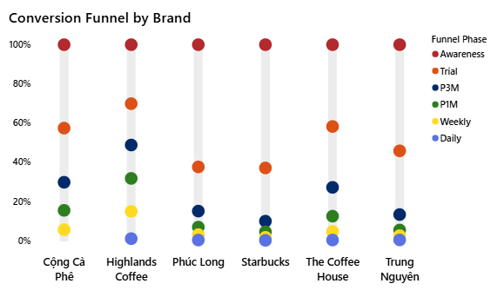
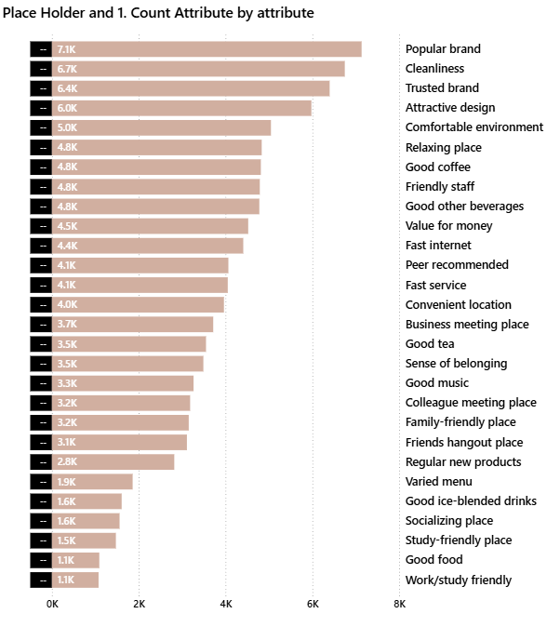
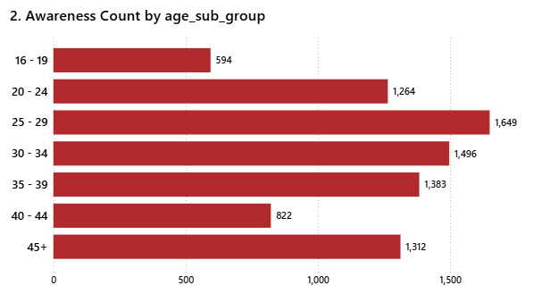
Customer Behavior
Analyzing customer activity, peak times, and store preference drivers

Slide 3
Competitive Landscape Dashboard
Analyze how major coffee brands compete in scale, growth, and awareness

Slide 4
Conversion Analysis Dashboard
Uncover key leakage points and understand what drives or hinders customer retention

Slide 5
Customer Insights Dashboard
Analyze customer perceptions and the value drivers they prioritize

Slide 6
RFM Analysis
Analyze customer loyalty across customer segments and demographics

Slide 7
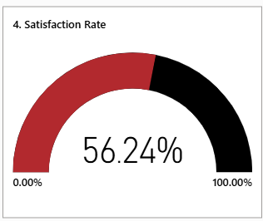
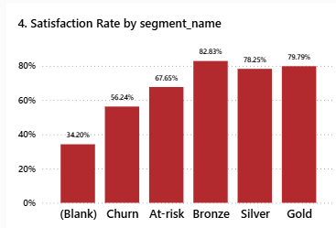
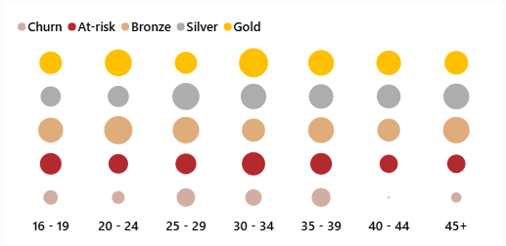
Satisfaction Analysis
Analyze the need satisfaction rate of each customer segment and loyalty level

